Slide 1

NURBS
Turbo Squid

Slide 2
Nonuniform Rational B-Splines
(NURBS)
  Basis function is a ratio of two polynomials (rational)
    Defined in 4-D space and projected to 3-D space
    Control points:
    Perspective division in the definition of the curve allows it to be represented in image space (unlike non-rational curves)
    Perspective division to come back to 3-D gives the “rational” nature
    Additional control of “weights” associated with each basis function that pull curve toward a point (w)

Slide 3
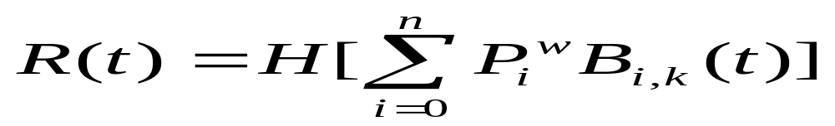
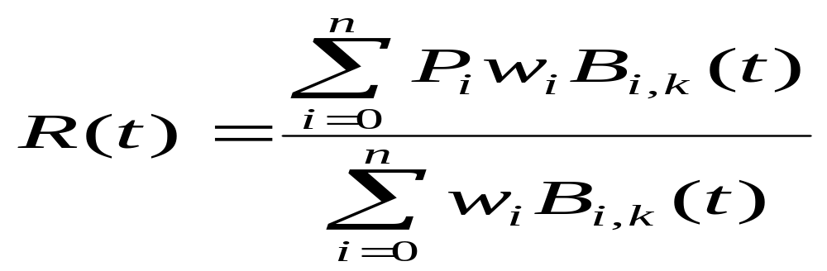
  Non-uniform: knot spans are not constrained to be equal
    Certain shapes cannot be represented by uniform B-splines (e.g. spheres, cylinders)
  In 4-D space
  Back to 3-D

